Slide 1
Obesity on a Global Scale
By: Greg Borowiak
http://www.ted.com/talks/dean_ornish_on_the_world_s_killer_diet.html
Obesity Greg Borowiak

Slide 2
Obesity related deaths has become a global epidemic due to poor diet.
Obesity Greg Borowiak

Slide 3
A Rising Epidemic
Cardiovascular disease has risen Globally.
The rate of obesity has increased exponentially in America over the past 10 years.
Obesity also leads to diabetes and hypertension.
Obesity Greg Borowiak

Slide 4
Obesity is completely preventable.
Healthy diets in other countries are being replaced with unhealthy ones.
There is a need to shift the focus back to healthier options in places such as fast-food chains.
Obesity Greg Borowiak

Slide 5
In Africa, obesity related deaths equals the total of HIV/AIDS related deaths.
It is an expanding epidemic.
America is more obese than it ever was, and is continuing to get heavier daily.
Obesity Greg Borowiak

Slide 6
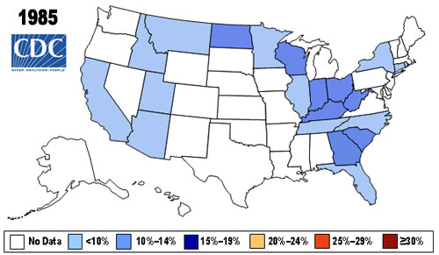
Obesity Greg Borowiak

Slide 7
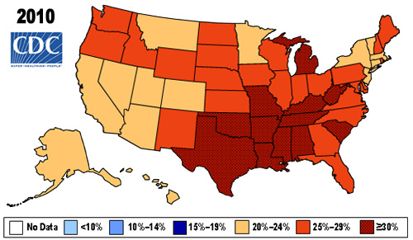
Obesity Greg Borowiak

