Slide 1
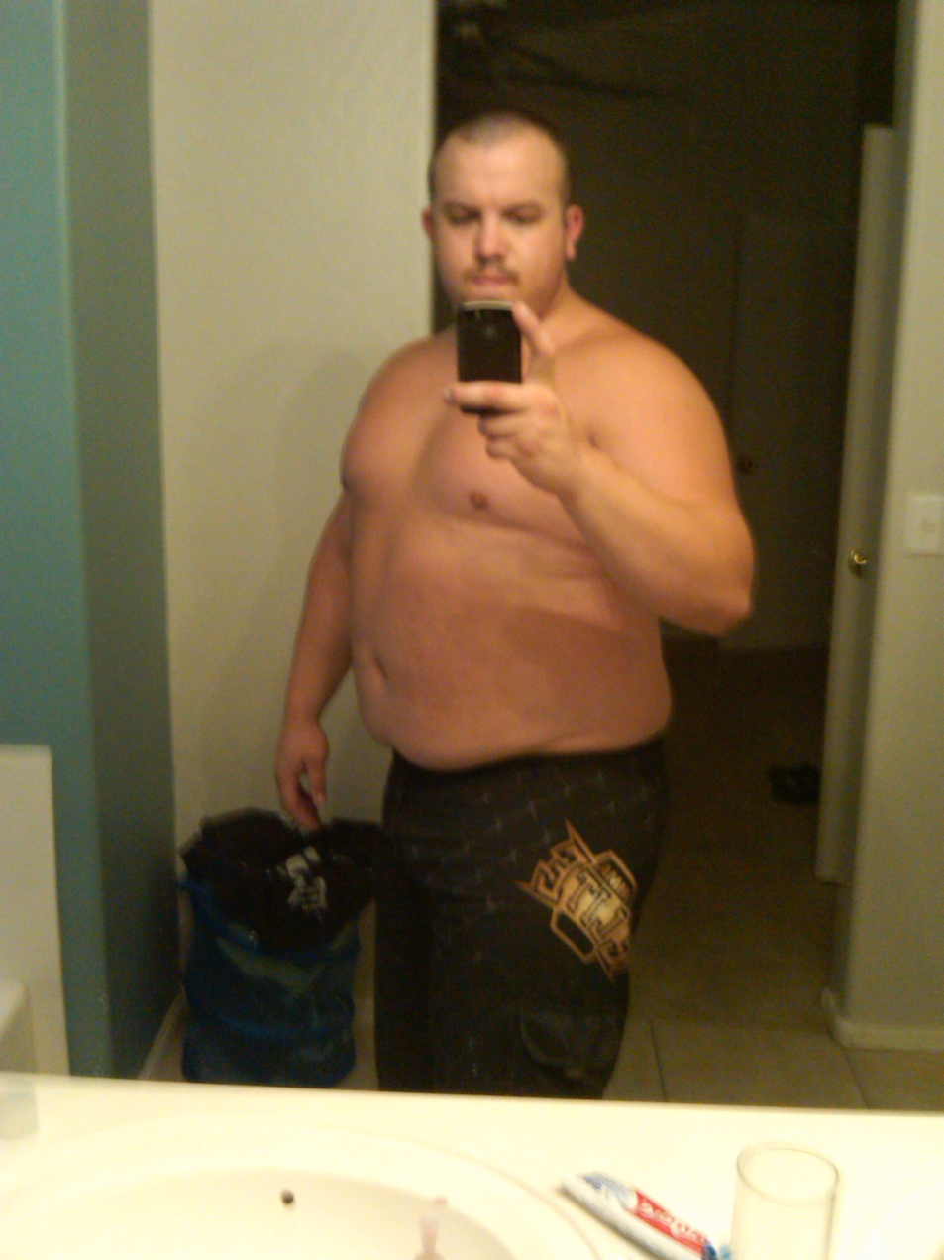
Photo credits: Tristan White
If I do a lot of sit-ups will I get rid of my belly fat?

Slide 2
NO!!!

Slide 3
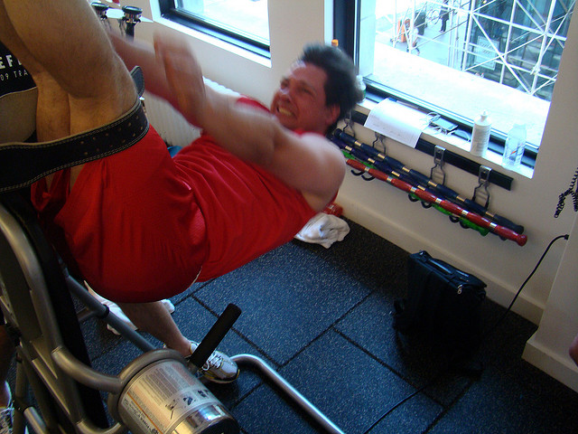
Photo credits: istolethetv
It is not possible to target burn while working out.
So when you do sit-ups to get rid of your belly you actually build muscle which will push the fat out making your belly look bigger.

Slide 4
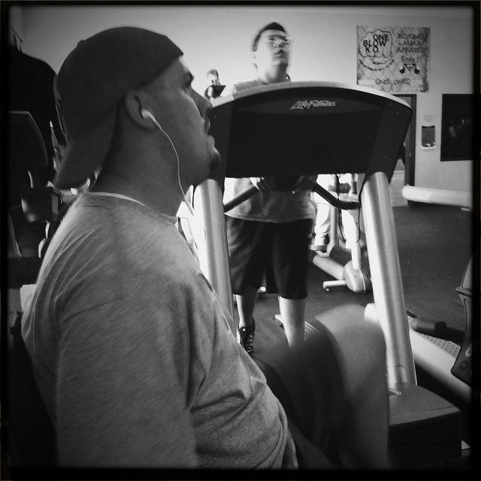
Doing crunches or sit-ups will help strengthen the abs. If you have excess fat in the belly you need to do cardio and be on a good nutrition plan to lose the fat first, or you will appear to be bigger since you are building muscle.
Photo credits: Clintus McGintus

Slide 5
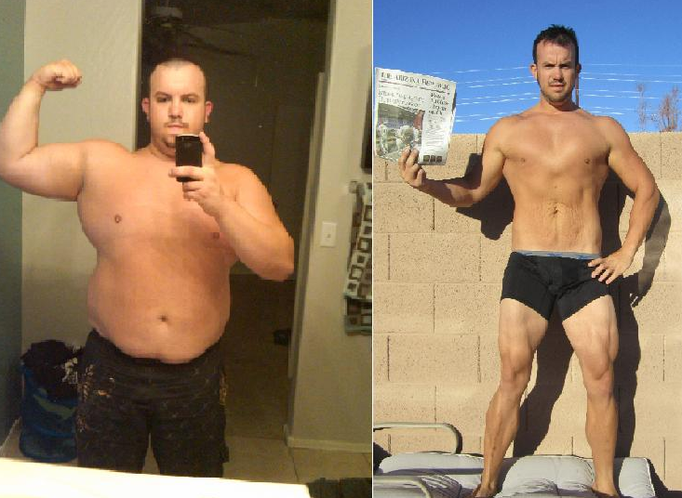
Photo credits: Tristan White
If you want more information go to http://www.livestrong.com/article/433411-how-many-sit-ups-should-i-do-to-get-rid-of-belly-fat/ , http://www.mayoclinic.com/health/health-tip/HT00209/rss=1 or bodybuilding.com.

