Slide 1
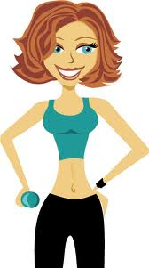
WOW
WOW
Health care and Weight Control Supervisor
Joseph Stanley and Namita Sindwani

Slide 2
More than one-third of U.S. adults (over 72 million people) and 17% of U.S. children are obese. During 1980–2008, obesity rates doubled for adults and tripled for children. During the past several decades, obesity rates for all population groups - regardless of age, sex, race, ethnicity, socioeconomic status, education level, or geographic region - have increased markedly.
Weight loss and regular exercise can help alleviate the harmful effects of being overweight. Studies show that if you are overweight or obese, losing 5% to 10% of your body weight can improve your health.
The safest and most effective way of losing weight is reducing your calorie intake and increasing your physical activities. Calorie intake depends on the lifestyle you live, the level of activity, etc.
Losing weight successfully depends essentially on
your enthusiasm and motivation. But even with the right enthusiasm, some people fail to be fit. They follow wrong diets, spend a lot of money, yet remain trapped in the obesity zone.
The reason behind this is people, have no idea what is the line that divides moderate and excess. Not all of them have help to keep them on the right track.
Our app comes to their rescue at such point.
WOW is a Health care application that supervises the diet and physical activity per individual and guides them to achieve their dream size and stay Healthy and Fit!

Slide 3
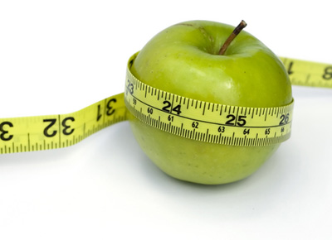
Watch YOur Weight
On first time access, create a personal account with your age, sex, current height & weight, desired weight, profession and medical details (optional) such as Body mass index(BMI), waist circumference, biometric impedance analysis(BIA), muscle mass etc
Based on these inputs, a dietician will set-up a diet and exercise schedule for the user
Now it always happens that now and then people do tend to eat food other than the diet mentioned. In such a scenario all the user has to do is click a picture of the food item whenever they eat.
The picture and details will be sent automatically to a micro-worker (preferably someone who cooks or knows about food) who will fill a form mentioning all the ingredients and their approximate quantity of the food. This will also mention any specific technique of cooking if any.
This form will be sent to the dietician who will calculate calorie, fat content etc and will modify(add/subtract exercises) the workout schedule to balance out the change in intake within a week!
In this way a constant vigil by a professional dietician is possible
Clients will also be provided with graphs indicating their progress and can view their complete diet history
Also in case the clients skip a particular scheduled exercise or get more exerted physically they can punch in a message which will modify their schedule accordingly.

Slide 4
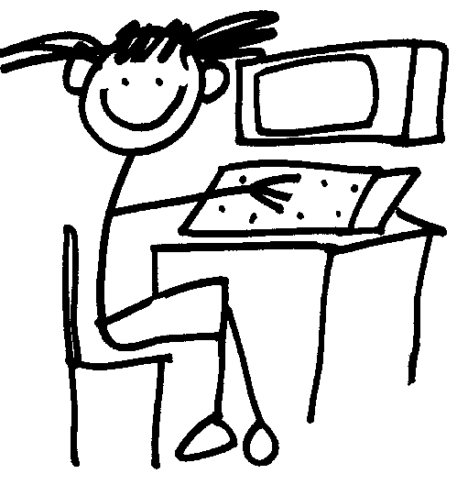
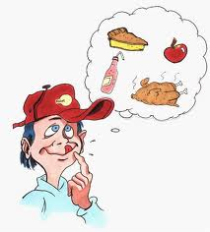
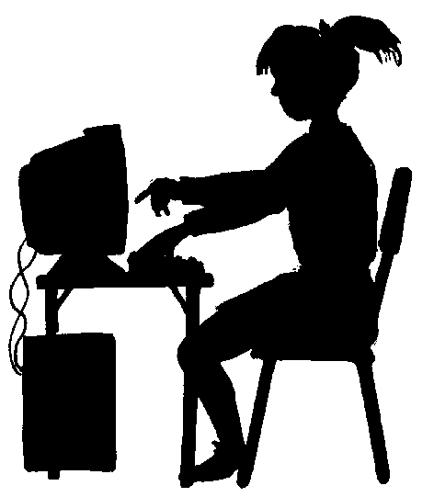
WOW Steps to stay Healthy
Step 1:
Profession
Height
Weight
Age
Sex
Create your personal account
Step 2: Get a custom diet and exercise plan from a professional dietician and FOLLOW IT!
Step 4:
if you want-to/going-to falter….. no problem! Just go to step 4
Step 6: Get the plan B from the dietician (to balance out the excess intake)
Step 4:
Click and send a picture of all the food that you are going to eat.
Step 5: Micro-worker gets the image and fills out a form with the ingredients and their approximate quantity.

Slide 5
Advantages
Constant watch on diet by a professional dietician for every single meal outside the recommended diet
Get a plan B incase any changes meet your plan A
Avoids the hassel of visiting the dietician all the time
Get your personal health history on graphs to measure performance
Low cost professional advise
Challenges
There will be a certain delay before the modified plan reaches the Client, there might be a possibility of certain non planned activities occurring in the delay period

