Slide 1
HUMAN DEVELOPMENT COGNITIVE AND PHYSICAL DEVELOPMENT IN MIDDLE CHILDHOOD Carlos F. Martinez MHA, M.Ed. http://carlosFmartinez.com

Slide 2
Overview
Aspects of Physical Development
Health, Fitness and Safety
Motor Development and Play
Piagetian Approach
Psychometric Approach: Assessment of Intelligence
Language
The Child in School
Educating Children with Special Needs

Slide 3
Body Growth
Grow 2 to 3 inches between ages 6 and 11
Kids double their weight between ages 6 and 11.
Average 10 yr-old boy = 85 lbs; average 10 yr-old girl = 88 lbs.
between 6 and 12 years, all 20 primary teeth are replaced with permanent teeth.

Slide 4
Nutrition and Sleep
Schoolchildren need an average of 2,400 calories every day.
Nutritionist recommend: fruits, grains, vegetables, and carbohydrates.
Average 5 yr-old sleeps 11 hrs a day.
Average 9 yr-old sleeps about 10 hrs a day.
Average 13 yr-old sleeps about 9 hrs a day.
Sleep problems: insomnia, lack of discipline.

Slide 5
Motor Development and Play
Running, jumping, hopping, and ball skills more refined
Fine motor skills improve-writing (starts off larger ad gradually decreases in size)
Drawings show gains in organization, detail ad representation of depth
Games with rules are more common. Children have a better concept of fairness, and justice
PE classes very important - builds self esteem, and physical activity

Slide 6
Obesity
By 2015 about 50% of children in North & South America will be overweight.
About 17% of schoolchildren had BMI above 95% (2003-2006).
About 33.3% were above 85%
Obesity has increased in all ethnic groups, though less so in black & Hispanic children.

Slide 7
Causes of Obesity
Genetics
Low-cost, high fat foods, and family stress
Food as a reward system
Lack of physical activity

Slide 8
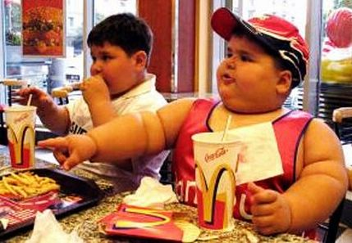
Causes of Obesity

Slide 9
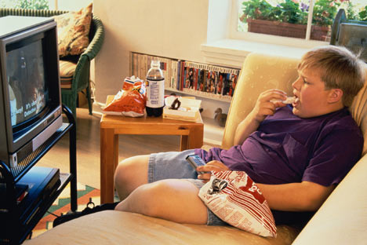
Causes of Obesity

Slide 10
Accidental Injuries
As in early childhood, accidental injuries is the # 1 cause of death among school-age US children.
About 23,000 children in the US suffer brain injuries from bicycle accidents.
Experts recommend that parents do NOT buy trampolines for their kids.

Slide 11
Preventing bike accidents…

Slide 12
Piagetian Approach
At around age 7 children enter the stage of “concrete operations” and they can use mental operations.
Most 6-7 yr.-olds can find their way to and from school.
Class Inclusion: the ability to see the relationship between the whole and its parts.

Slide 13
Psychometric Approach: Assessment of Intelligence
The IQ Controversy:
*) Good predictors of school achievement; functional independence late in life; and presence or absence of dementia later in life.
*) Tests underestimate the intelligence of ill children, or children who do not do well on tests; do not measure native ability, but what children already know (infer intelligence)

Slide 14
Is there more than one intelligence?
Gardner’s Theory of Multiple Intelligences:
Conventional intelligence tests cover 3 areas: linguistic, logical-mathematical, and to some extend spatial (i.e gifted in art).
Other 4 areas not covered in IQ tests: musical, bodily-kinesthetic (precision of movement), interpersonal (social relations), and intrapersonal (self-understanding).
Later discover an 8th one: Naturalist (i.e. distinguishing species).

Slide 15
Language
Language abilities continue to grow during middle childhood
Get better with oral communication
Improve their written communication
More challenging for children who are not native-language speakers.

Slide 16
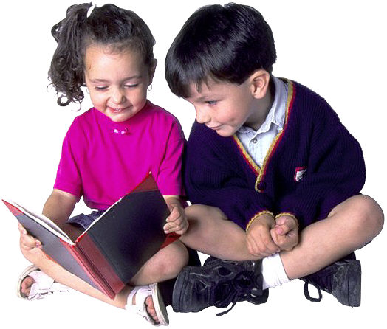
The Child in School
Early school experience critical for success or failure
Becoming Literate: Reading and Writing

Slide 17
The Child in School…Continue
Gender (Girls tend to do better than boys)
Boys do better than girls on science and math tests that are not closely related to material taught in school
Peer acceptance
Socioeconomic Status

Slide 18
Educating Children with Special Needs
Mental Retardation
Learning Disabilities. (Dyslexia)
Attention-Deficit/Hyperactivity Disorder (ADHD)
Gifted Children

Slide 19
Questions?
THANK YOU!
carlos@carlosFmartinez.com

